Slide 1
CONFIDENTIAL
Jungle Riders
2020-06 CONFIDENTIAL

Slide 2







CONFIDENTIAL
Decision
Agile
Choice

Slide 3

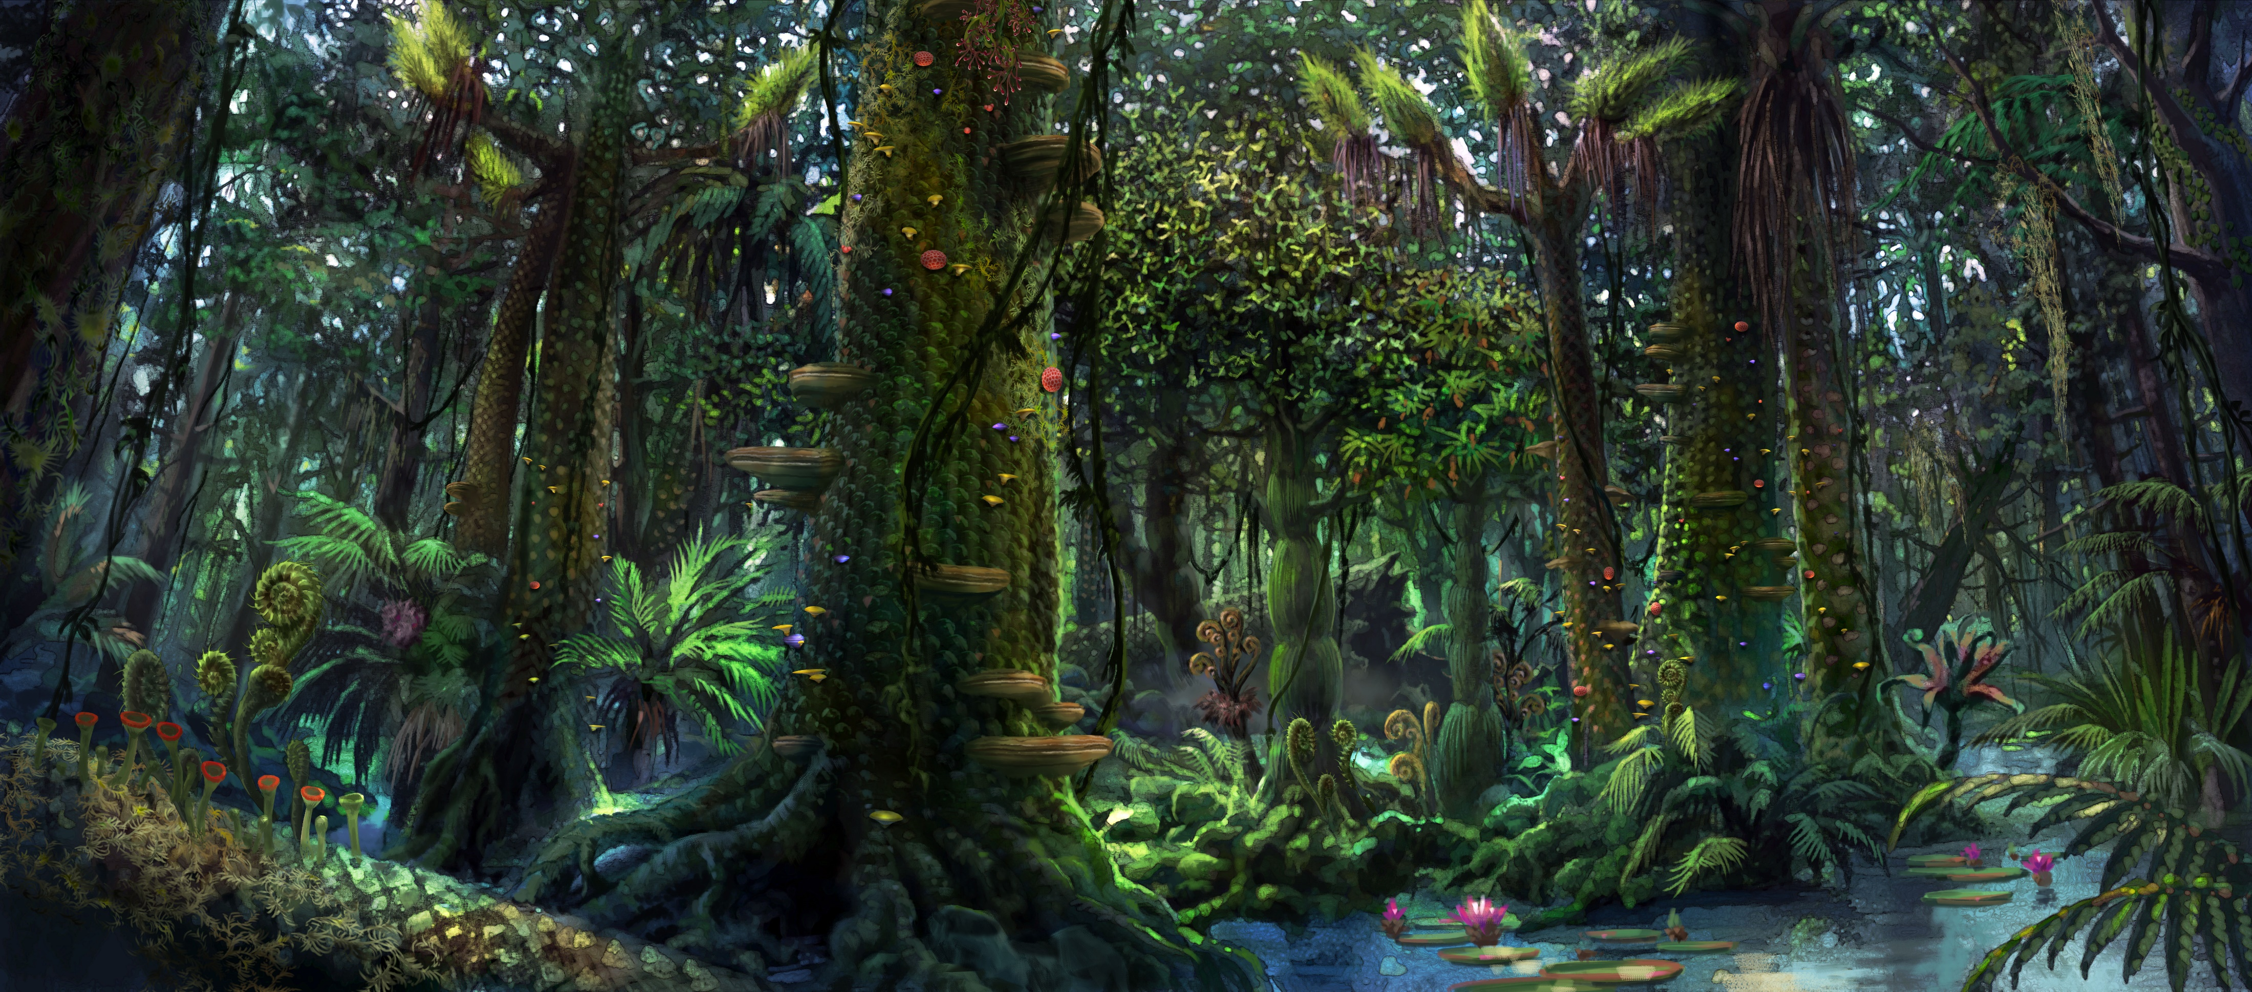
CONFIDENTIAL
＝

Slide 4

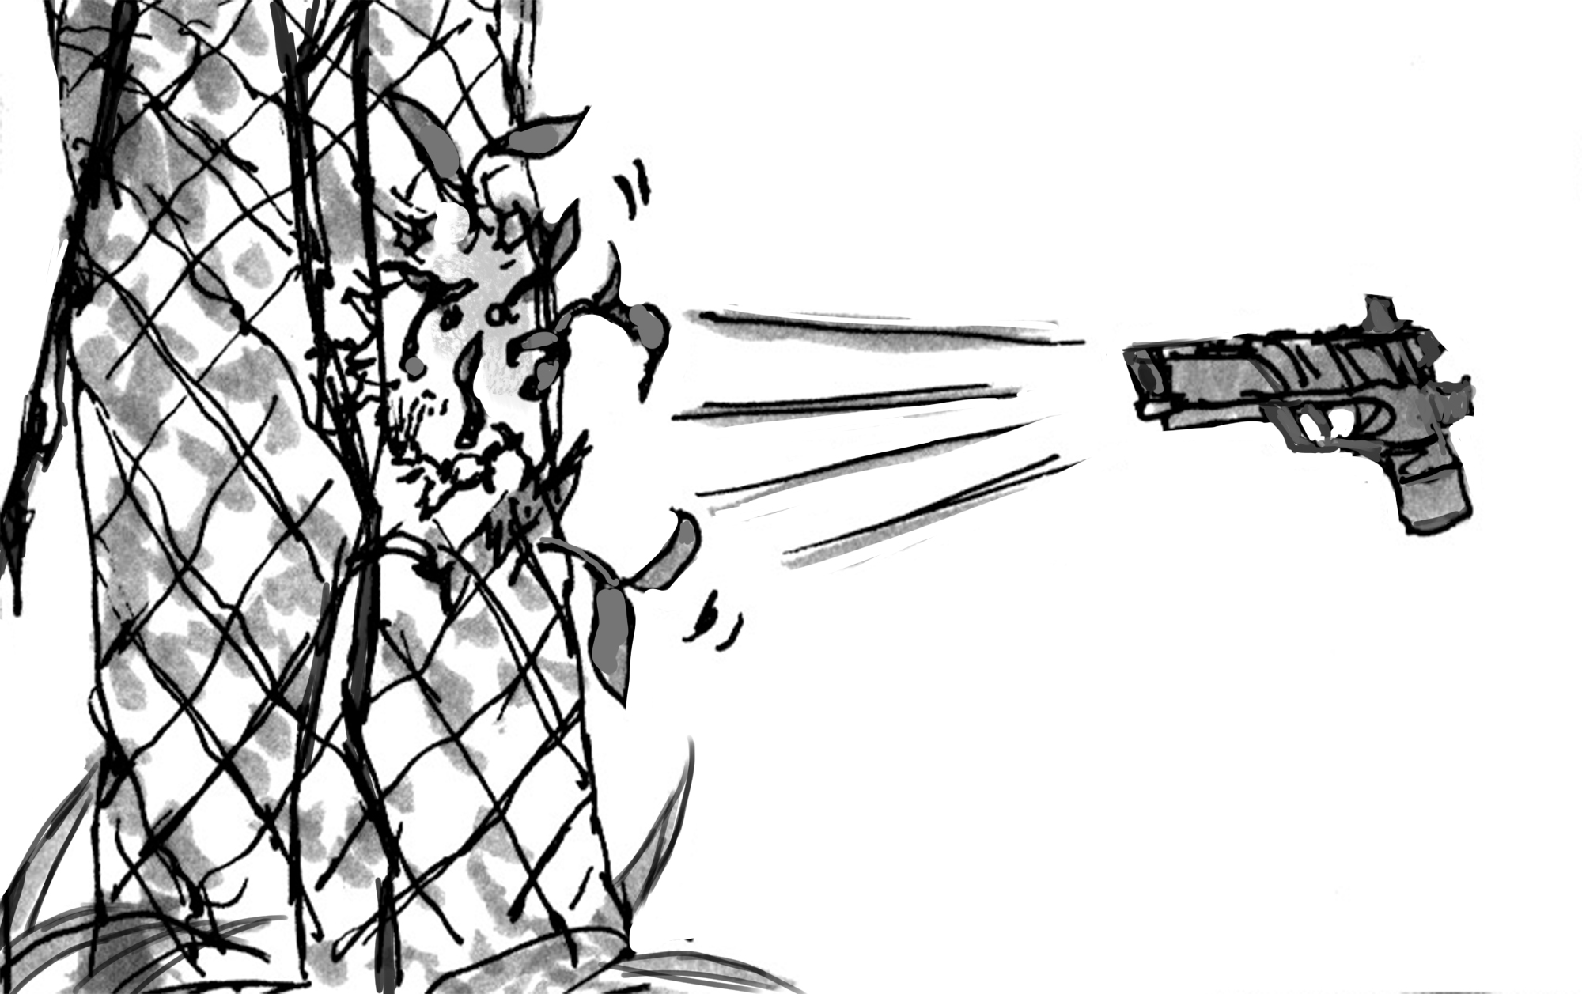
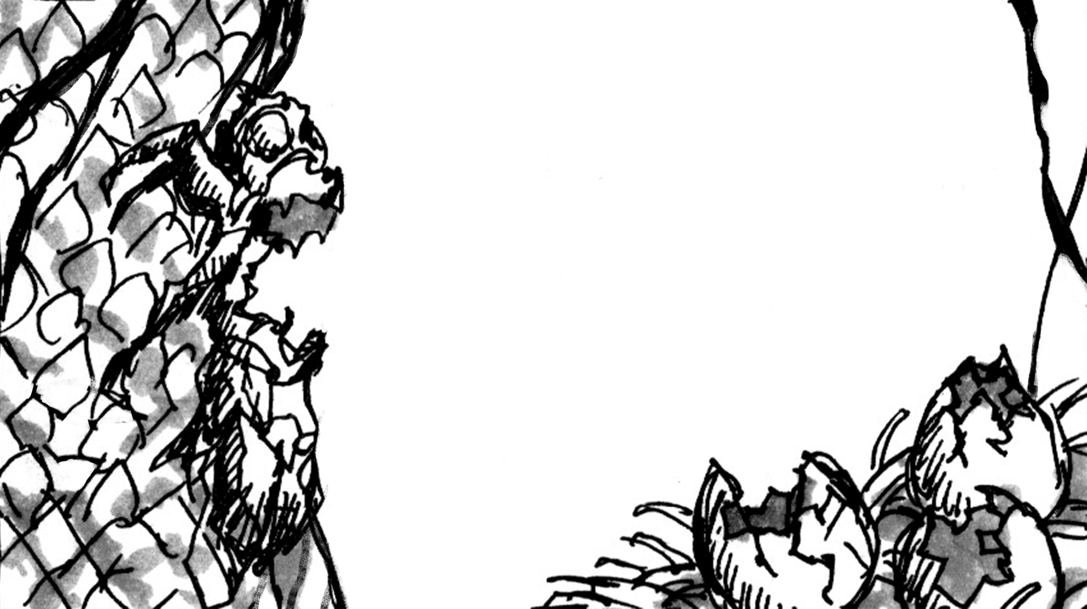
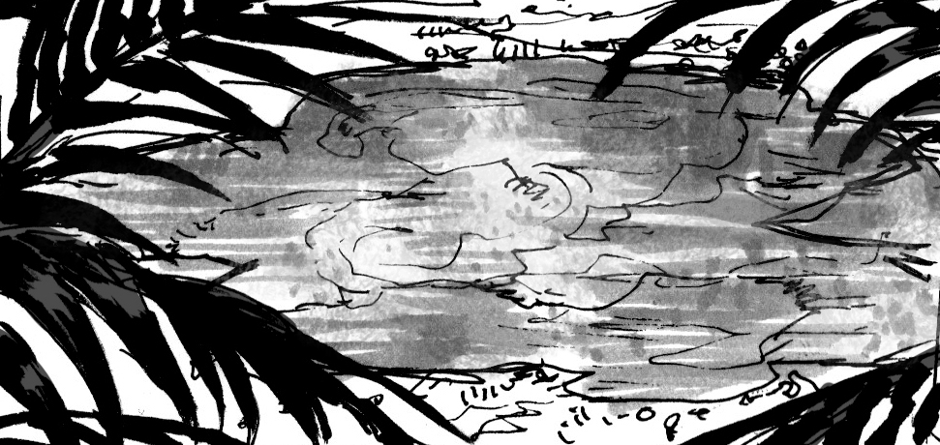
CONFIDENTIAL
Decision
+
Regeneration
木の成長

Slide 5
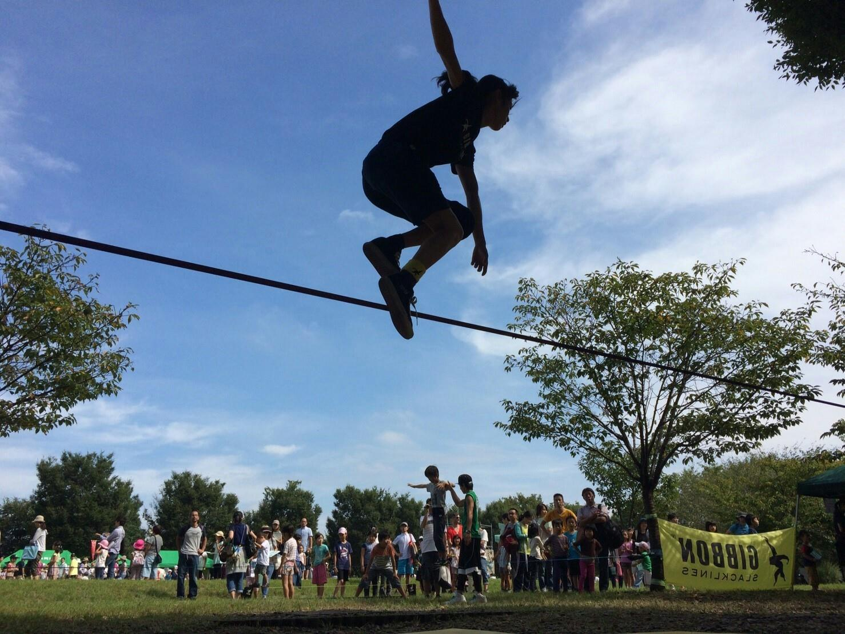
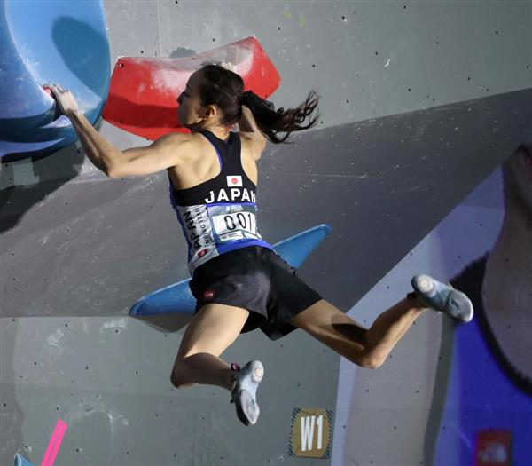
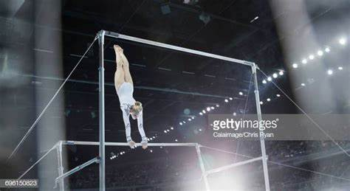
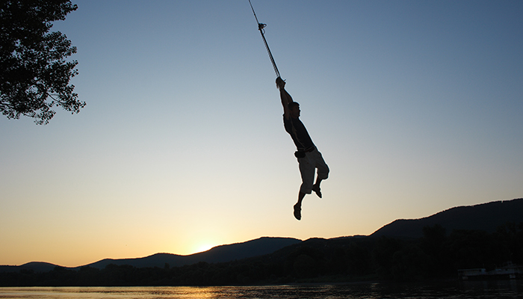
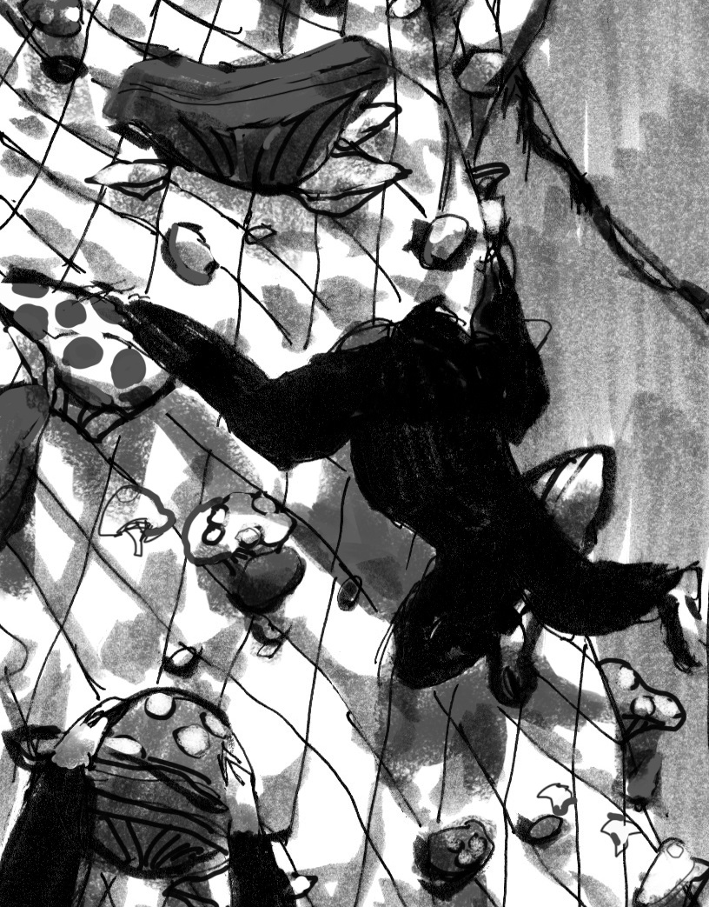
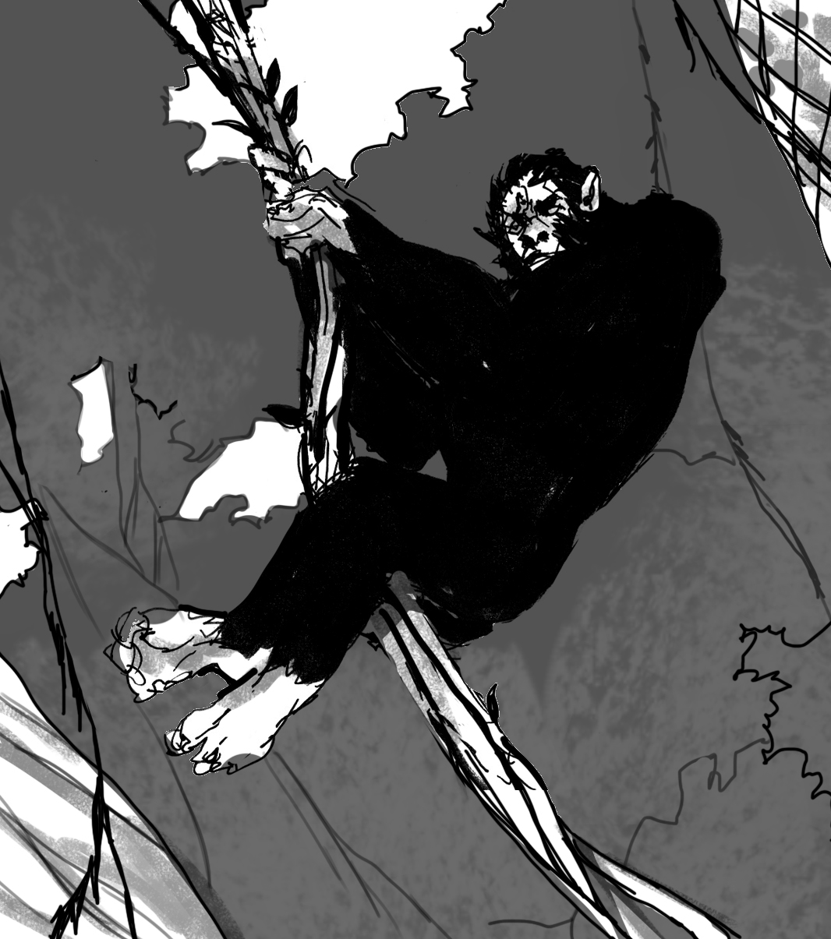
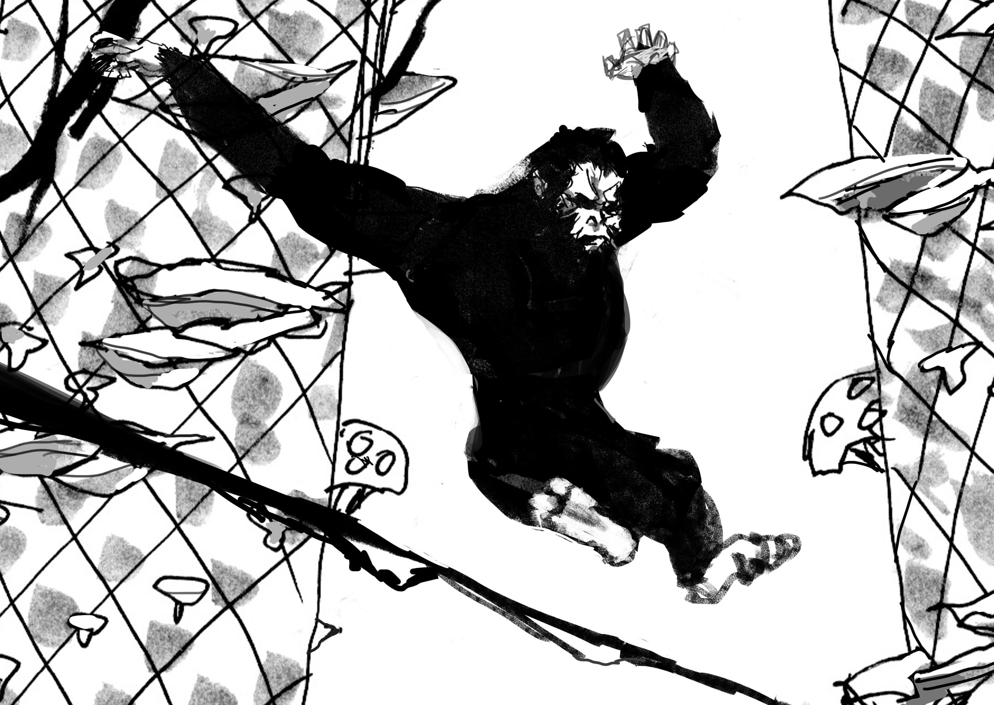

CONFIDENTIAL
Agile

Slide 6
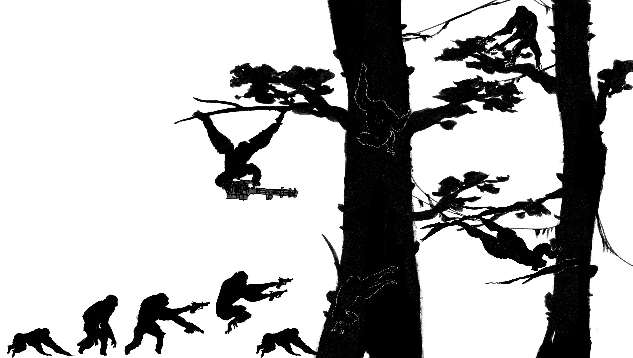
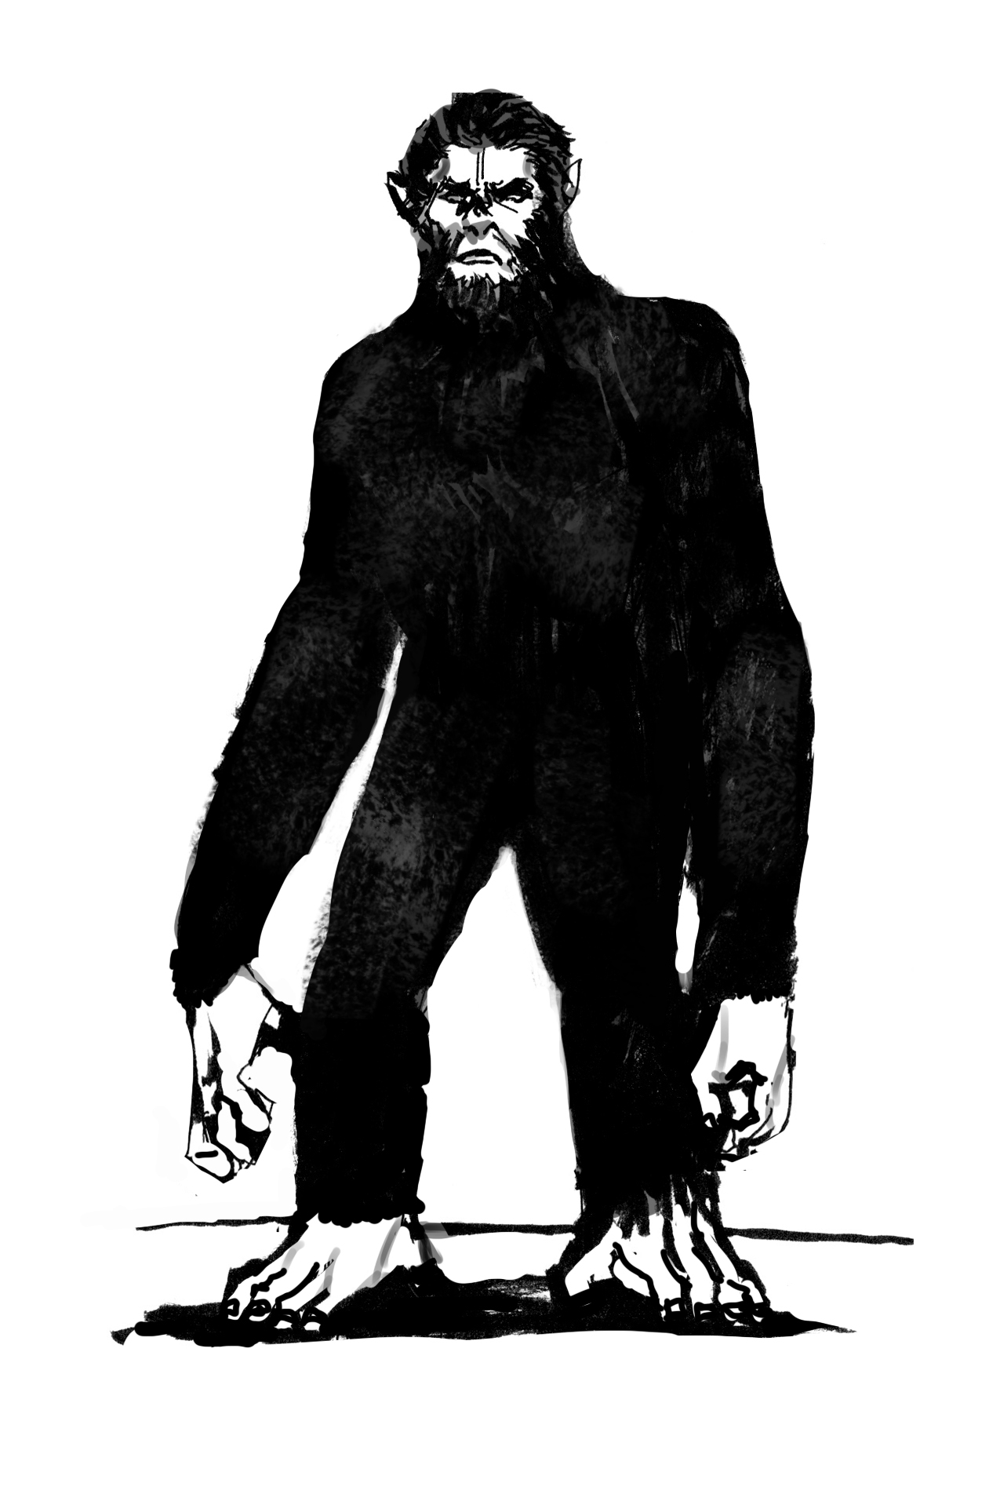
CONFIDENTIAL
Go Wild

Slide 7
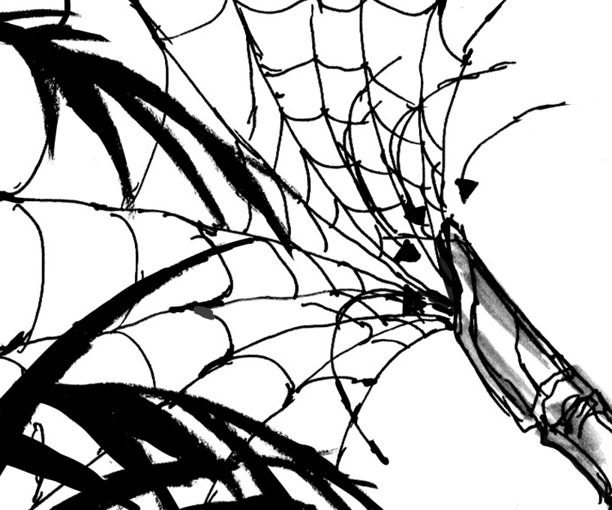
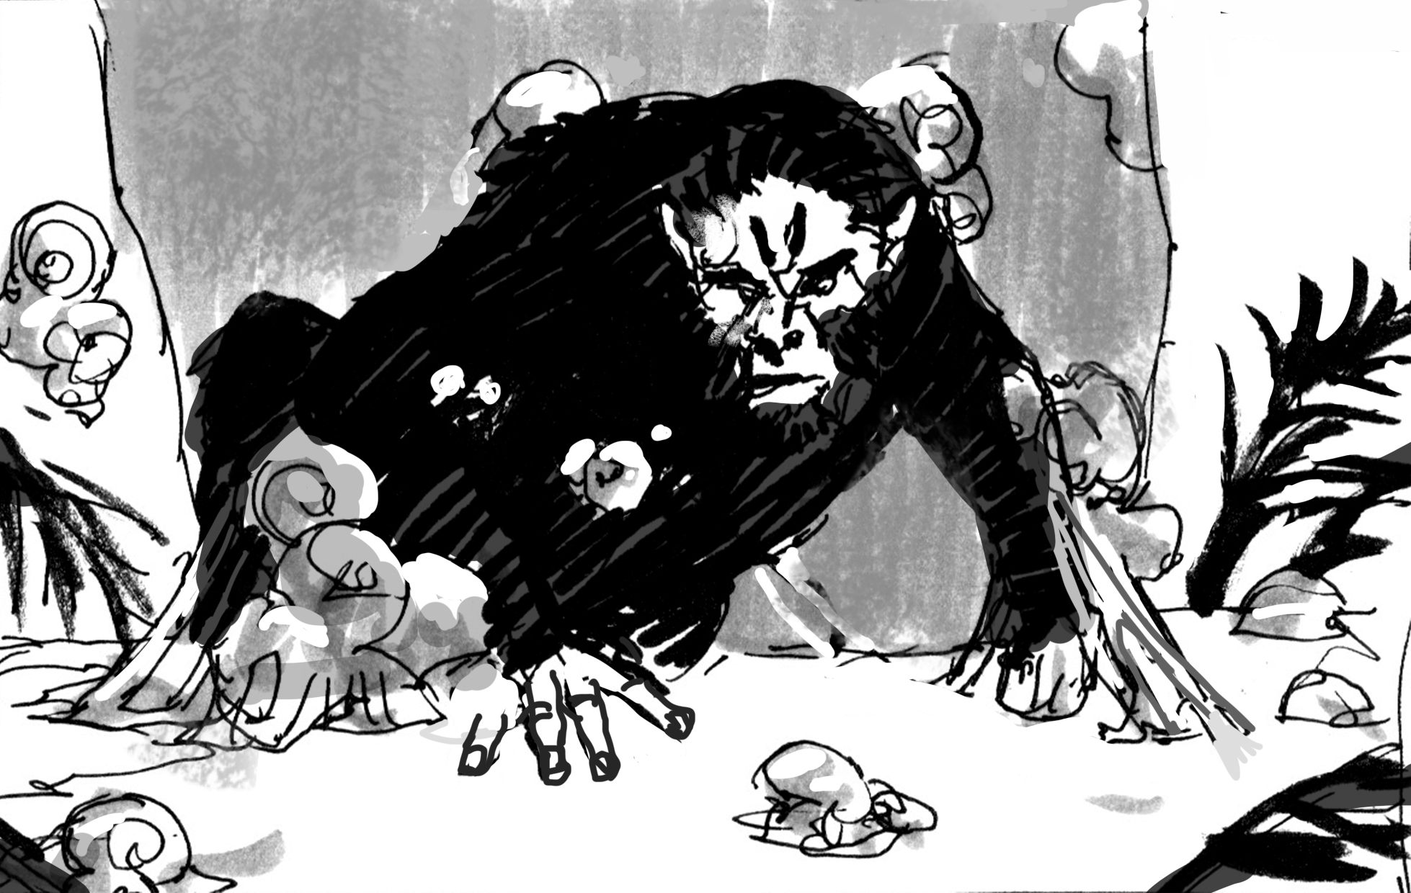
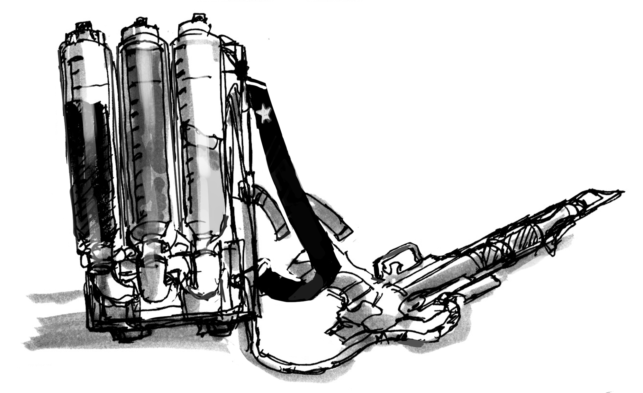
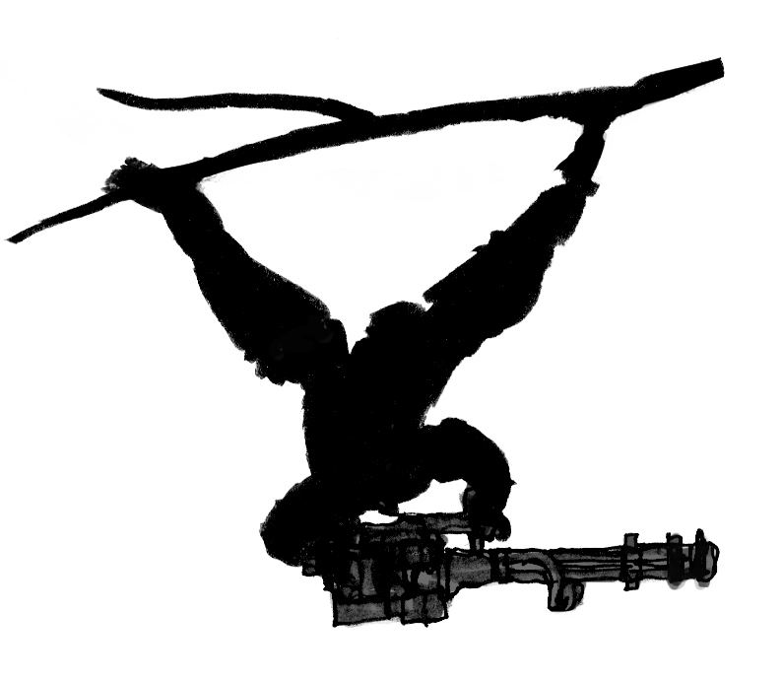

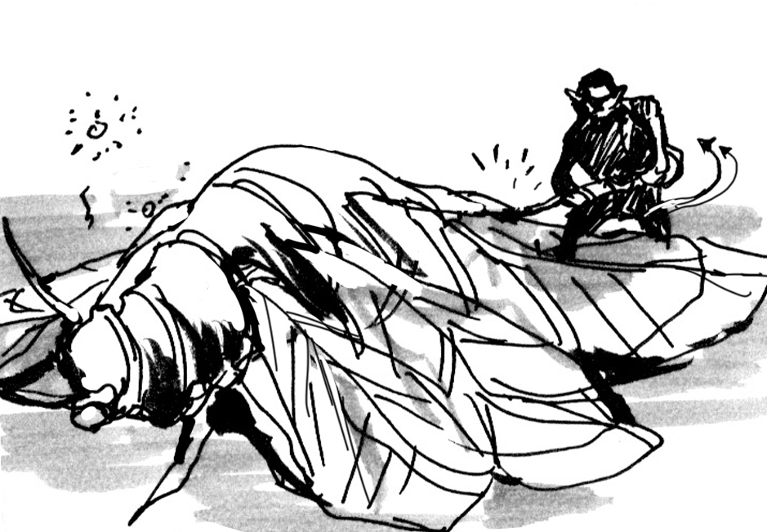


CONFIDENTIAL
Choice
Knockout

Slide 8


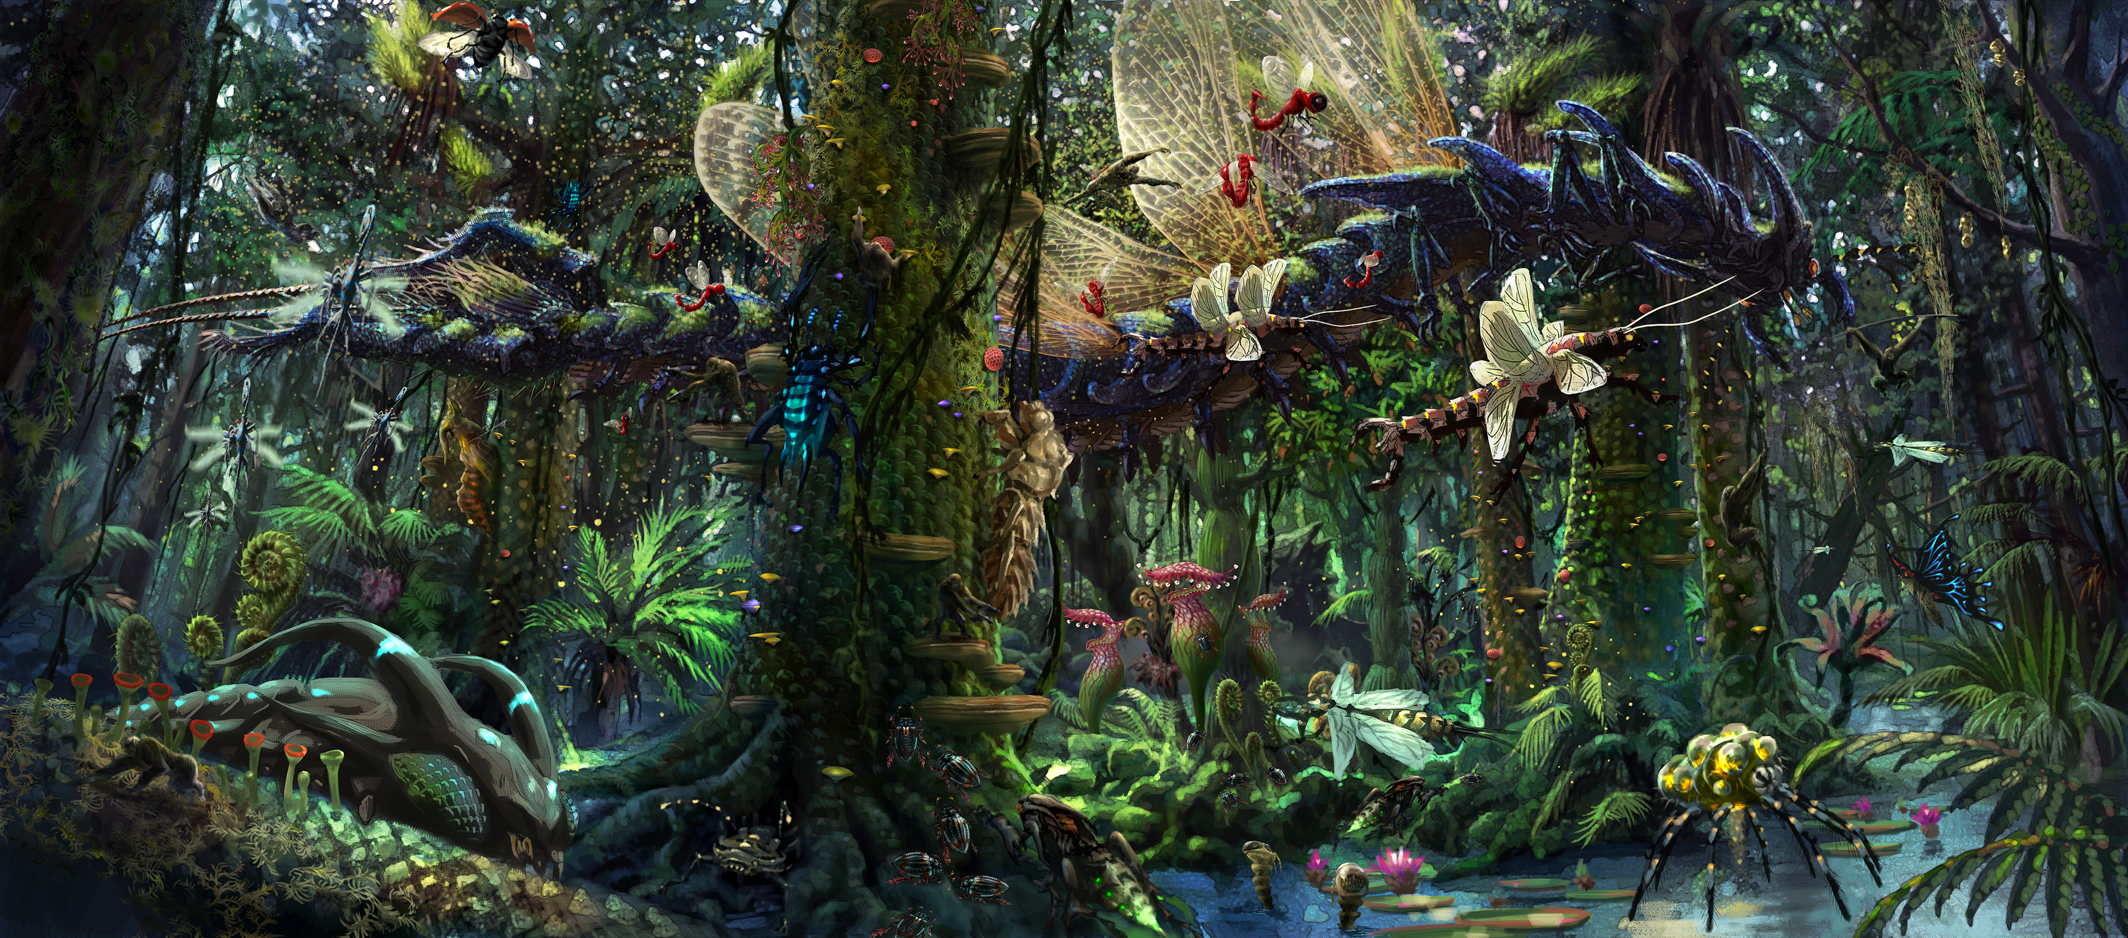
CONFIDENTIAL
+
+
+

Slide 9
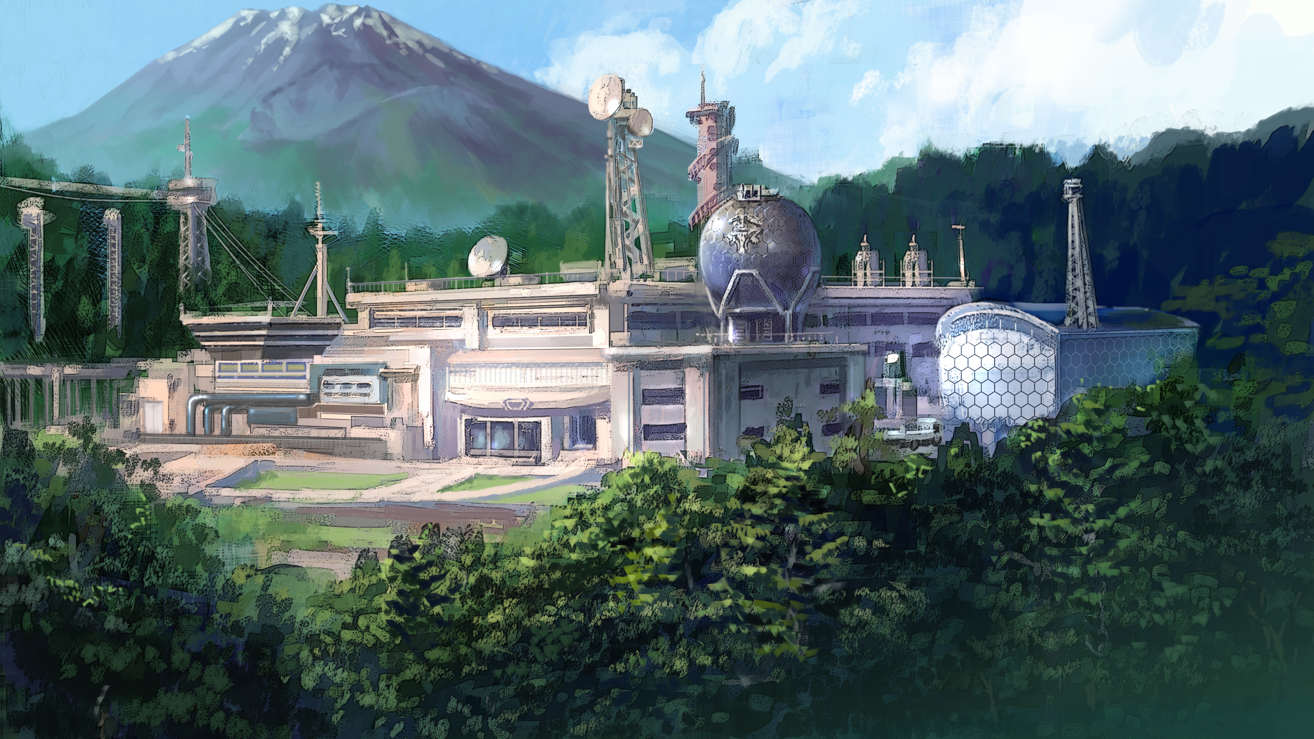
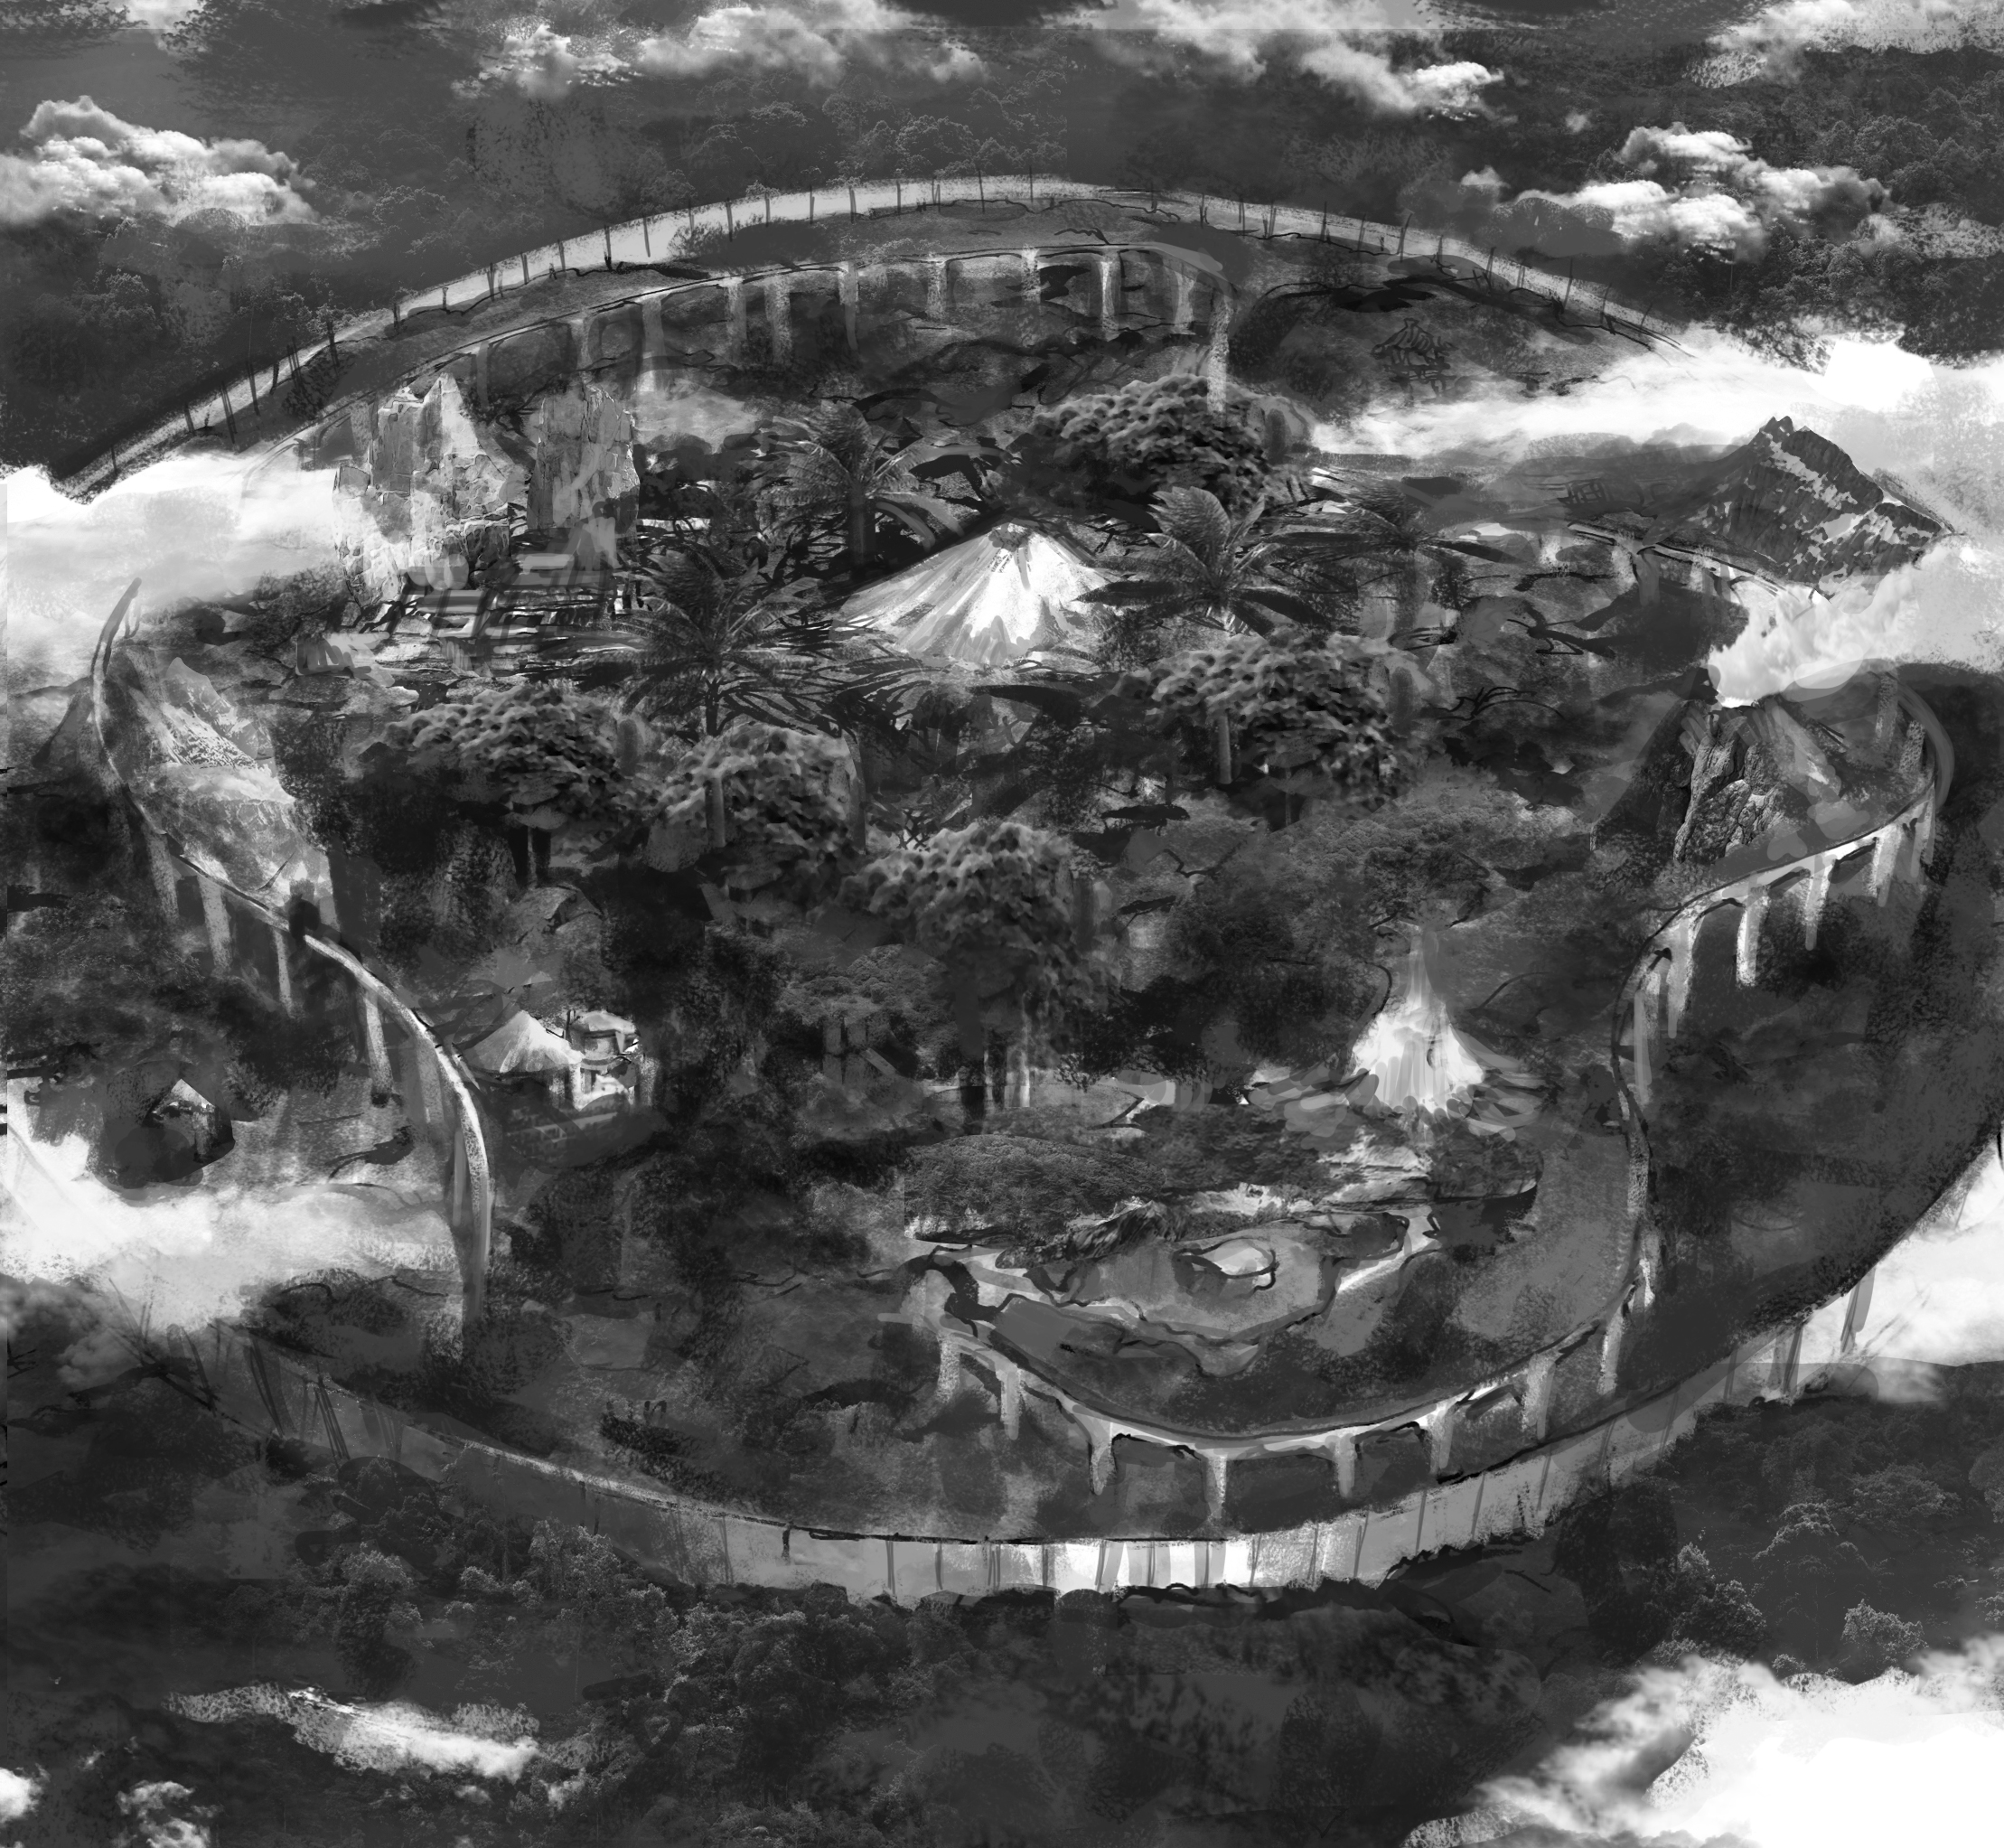
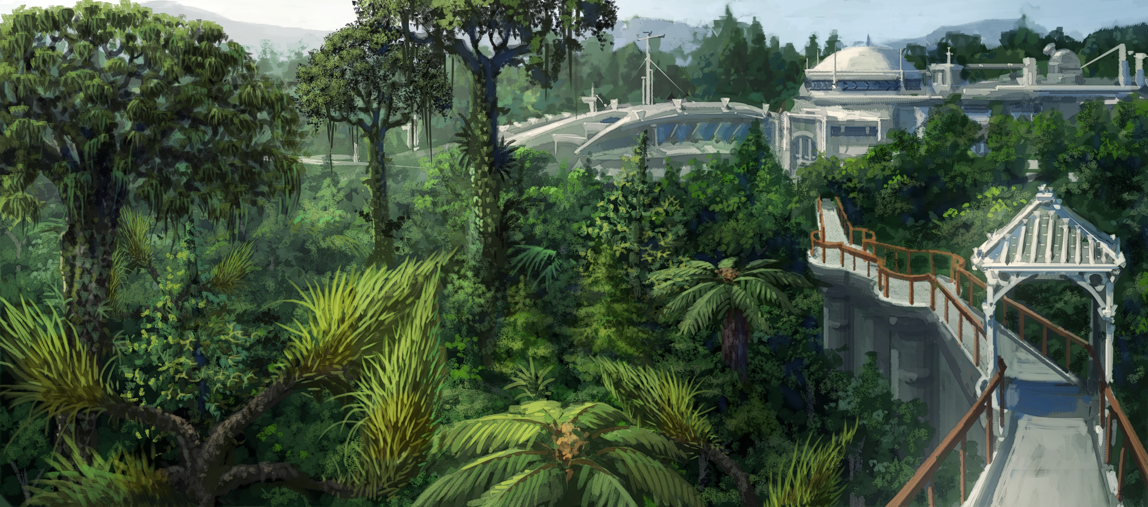
CONFIDENTIAL
The Ancient Botanical Garden

Slide 10
Game volume
Shop
Solo
Duo
Trio
No mercy
Royal
Battle Lobby
Game coin
Setting
Squad
50 VS 50
Collaboration
Event
Battle Lobby
Enjoy pass
Arena
4 VS 4
Battle Lobby
Main Lobby
Qualifying
Solo
Duo
Trio
4 VS 4
Notice screen
Match
Battle Lobby
Match
Garden
Lobby
Setting
Match edit
Video Check
ON AIR
Broadcast
Battle Lobby

Slide 11




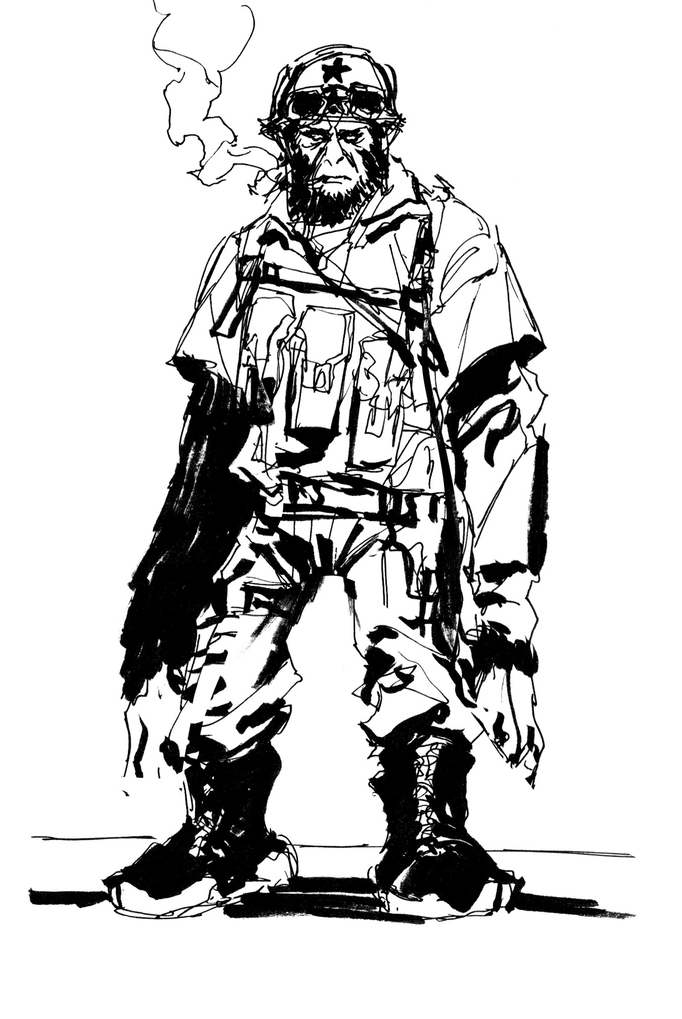
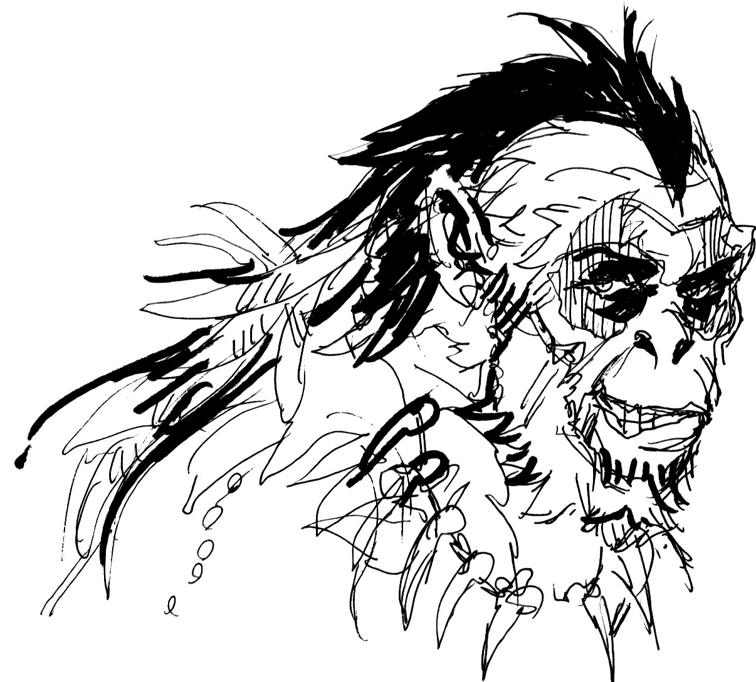

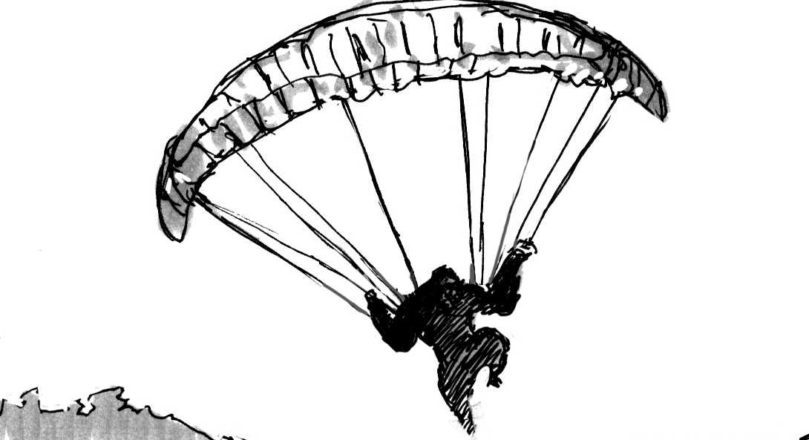

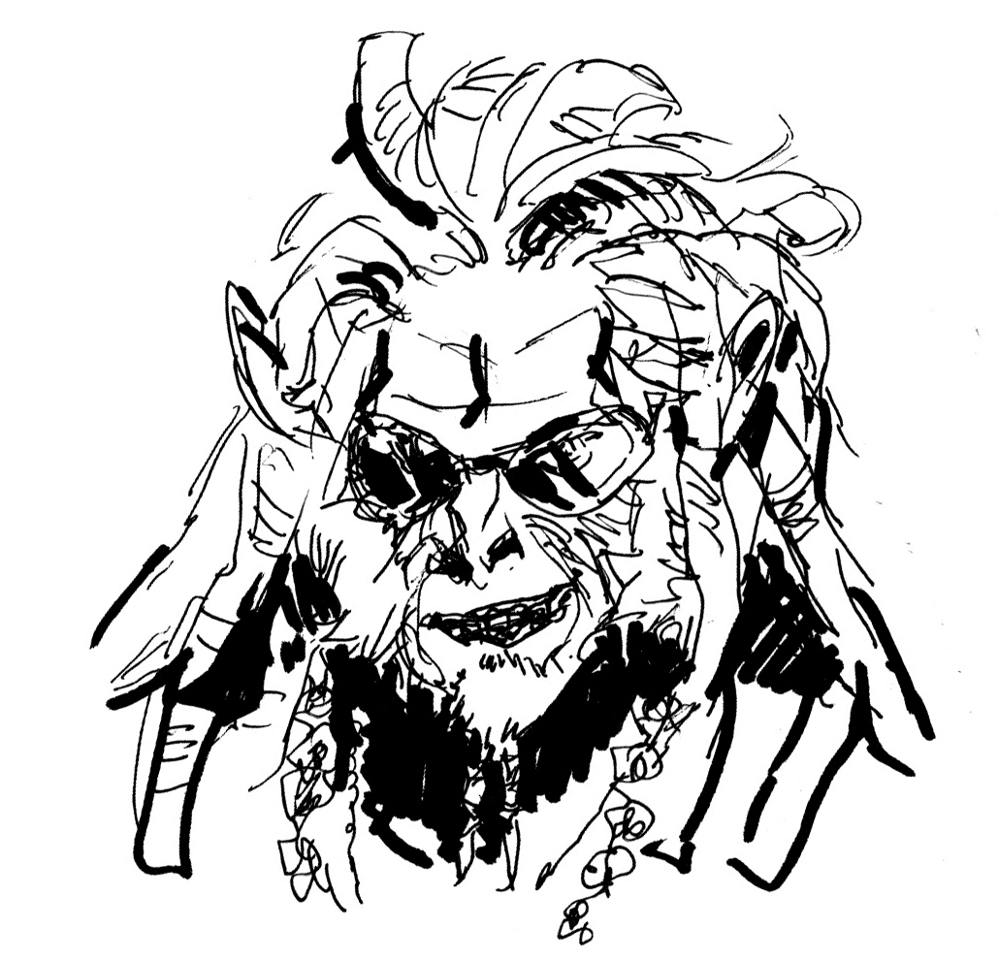

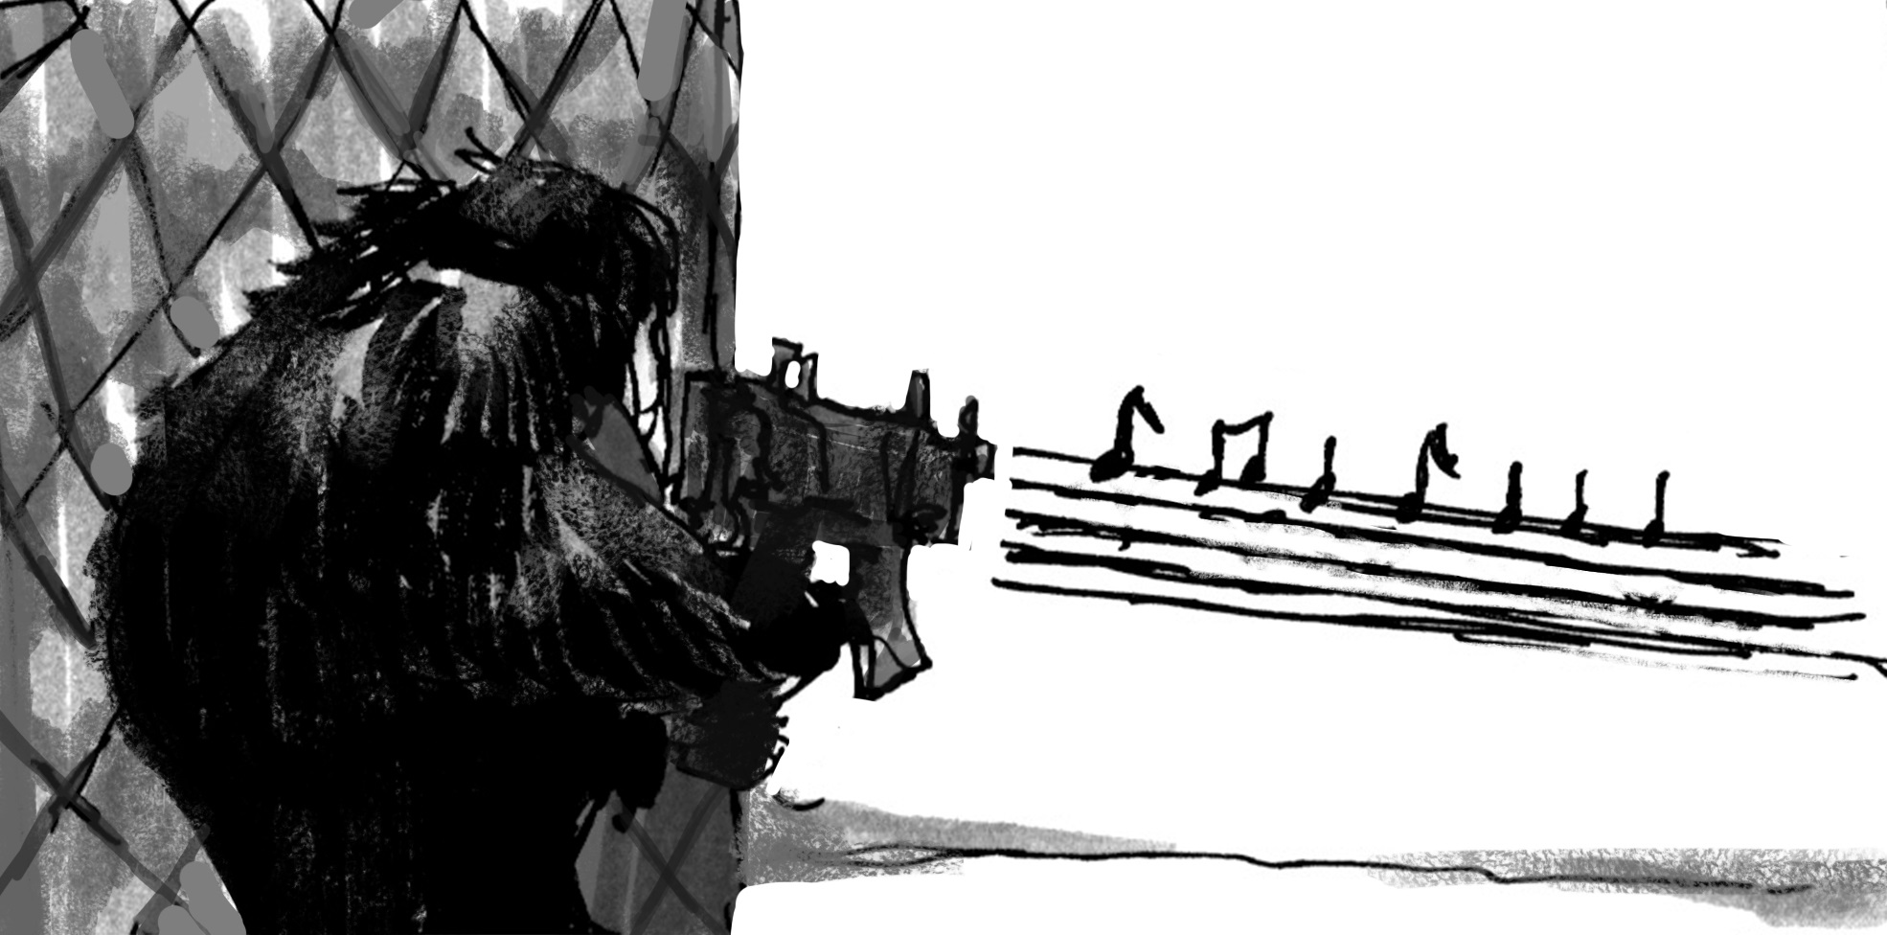
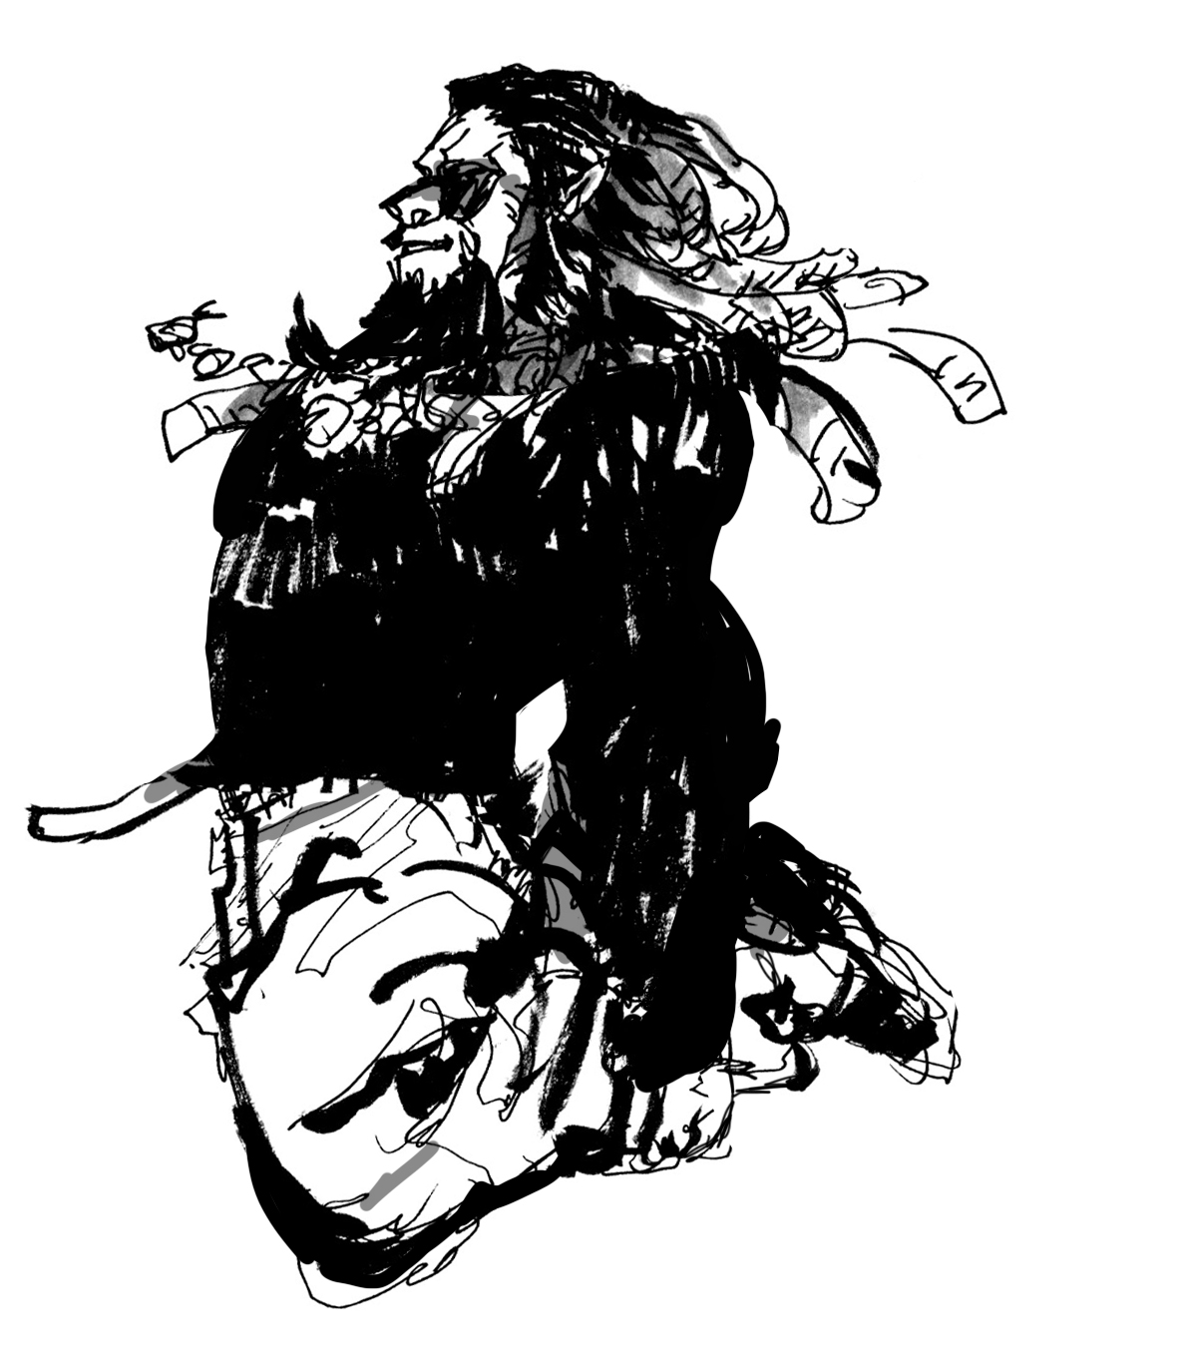
CONFIDENTIAL
Product
Enjoy Pass
Skin
Glider
?
?
Shoot effect
Trick
Wrap
Music
Axe
Coin
=Tier

